Slide 1

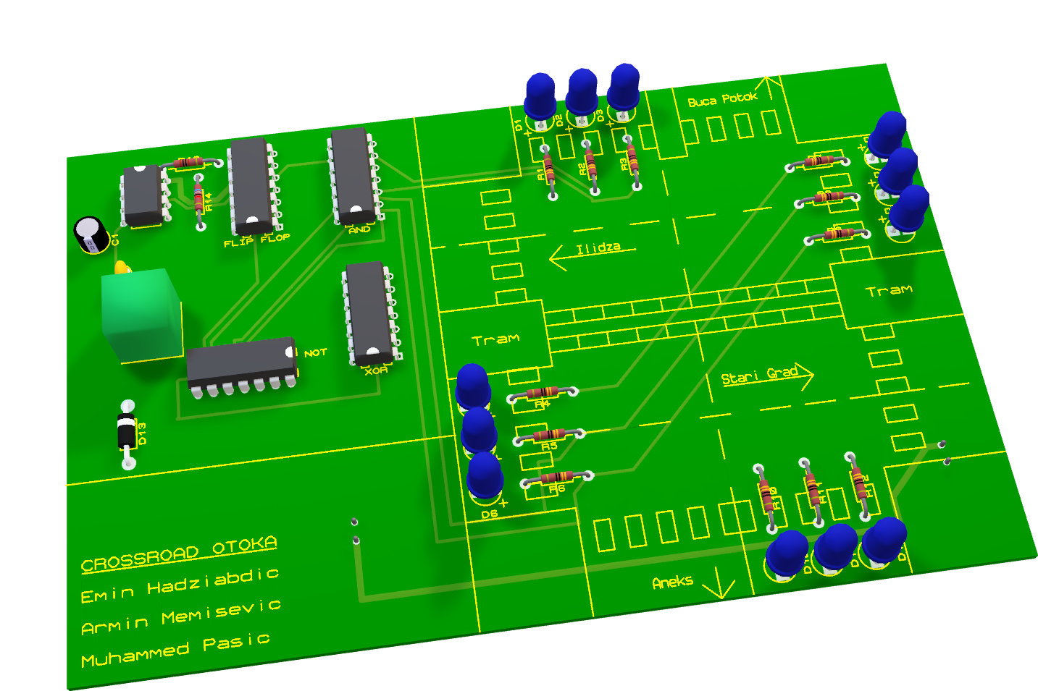
https://github.com/ehadziabdic/Crossroad-Trafficlight-System
OTOKA CROSSROAD
Traffic-light controller
Formal verification of a synchronous Moore FSM · 4 states · 6 properties · 5 DIP packages · zero-error PCB
Emin Hadžiabdić · Armin Memišević · Muhammed Pašić | Prof. Dr. Aida Branković · ETF Sarajevo · 2025/26
Logic Design · Formal Verification · Electronic Schematics · PCB Design · Practical Implementation

Slide 2
OTOKA CROSSROAD · FORMAL MODELS · ETF SARAJEVO
Introduction - The Otoka Crossroad
Bulevar Meše Selimovića × Buća Potok / Aneks · prove first, then solder.
Never two greens
Conflicting movements mutually exclusive at all times — not merely in normal operation.
Never starve a driver
Every red approach turns green within a bounded number of ticks.
Never snap to red
Green → yellow → red. Abrupt changes cause rear-end collisions.
TEMPLATE
METHOD — SPECIFY → PROVE → BUILD
Testing shows a fault did not occur during observation. Proof shows it is impossible. Six properties, four models, one board.

Slide 3
OTOKA CROSSROAD · FORMAL MODELS · ETF SARAJEVO
LOGIC DESIGN & VERIFICATION

Slide 4
LOGIC DESIGN & VERIFICATION – Logic Design
2 · Logic design — synchronous Moore FSM
Up-count encoding · one XOR + one inverter · zero OR gates.
State | Q1 Q0 | East–West | North–South
S0 | 0 0 | GREEN | RED
S1 | 0 1 | YELLOW | RED
S2 | 1 0 | RED | GREEN
S3 | 1 1 | RED | YELLOW
Next state
D1 = Q1 ⊕ Q0 D0 = ¬Q0
TEMPLATE
Outputs
GEW=¬Q1·¬Q0 YEW=¬Q1·Q0 REW=Q1 GNS=Q1·¬Q0 YNS=Q1·Q0 RNS=¬Q1
Why it is safe
GEW needs Q1=0, GNS needs Q1=1 — one wire, one voltage. Conflict excluded by encoding.

Slide 5
LOGIC DESIGN & VERIFICATION – Formal Verification
3 · Formal verification — four models, six properties
Each model chosen for what the others express poorly.
LTS · graph facts
Proc={S0..S3}, Act={clk}. Reachability by traces; out-degree 1 → deadlock-free single 4-cycle.
PETRI NET · structure
P-invariants: exactly 1 lamp per approach. T=(1,1,1,1) cycle. C·n=ΔM inconsistent → crash unreachable.
TEMPLATE
LTL · time
G¬(GEW∧GNS) by tautology + BMC k=4 · G(RNS⇒FGNS) ≤2 ticks · G(GEW⇒XYEW).
MARKOV · faults
0.97 intended / 0.01 glitch. Crash prob. stays 0. Bellman U(S0)≈47.95, U(S1)≈42.05.

Slide 6
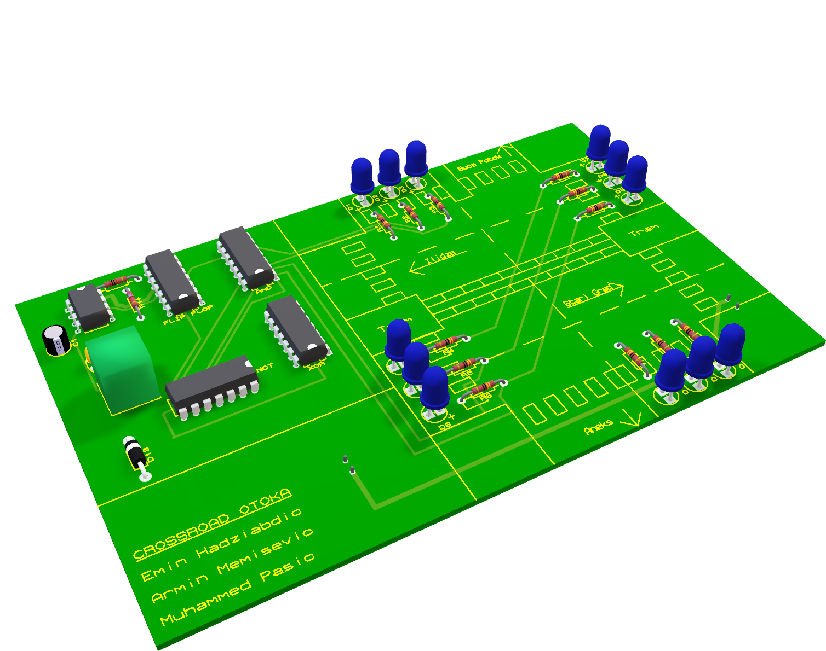
OTOKA CROSSROAD · FORMAL MODELS · ETF SARAJEVO
DIGITAL
IMPLEMENTATION & SIMULATION

Slide 7
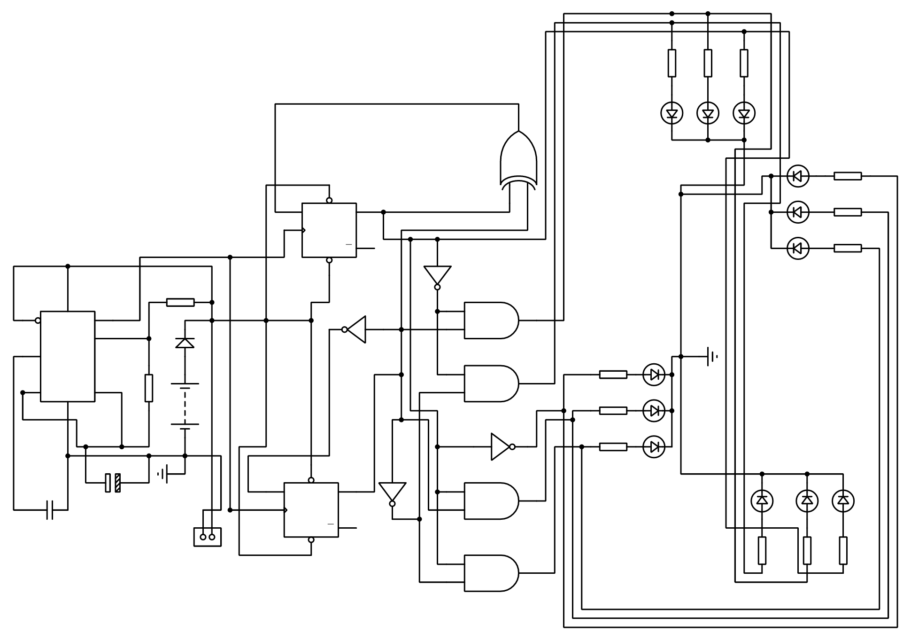
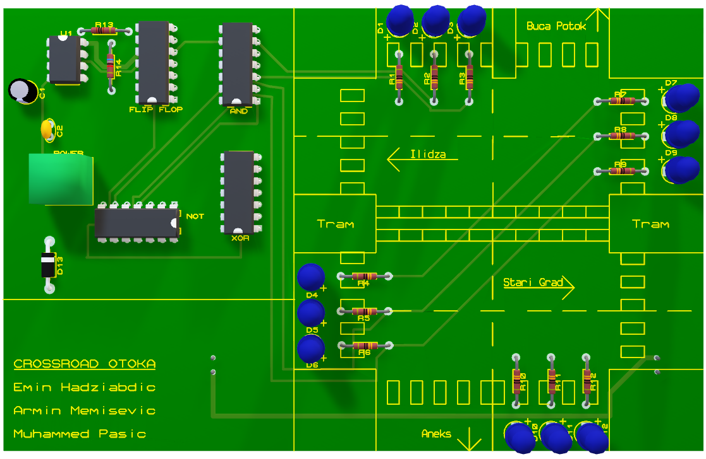
DIGITAL IMPLEMENTATION & SIMULATION – Electrical Schematics
Title / Main claim
text
Title / Main claim
text
Title / Main claim
text

Slide 8
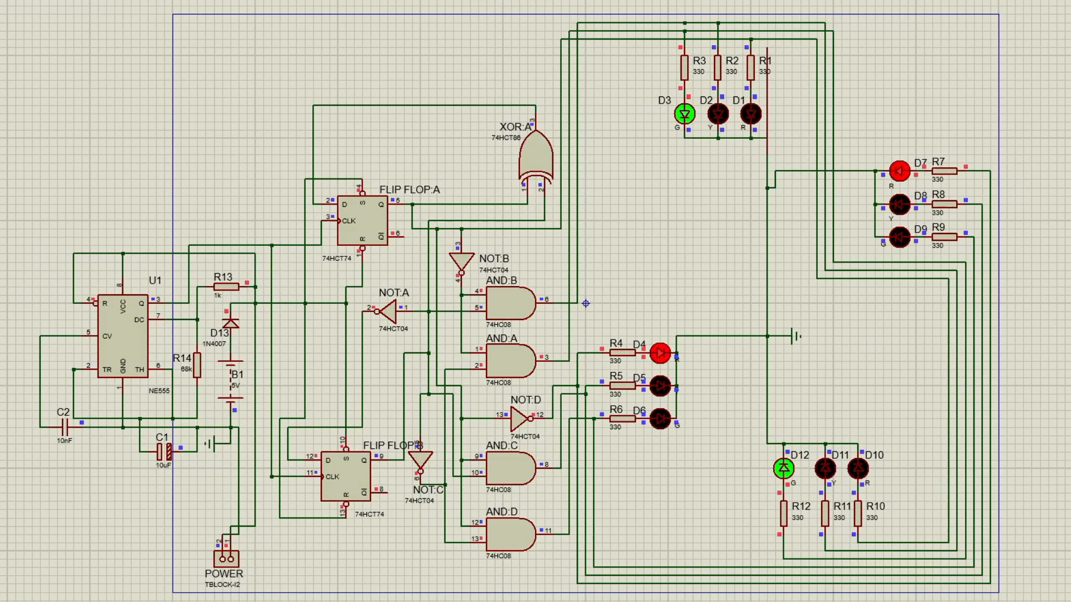
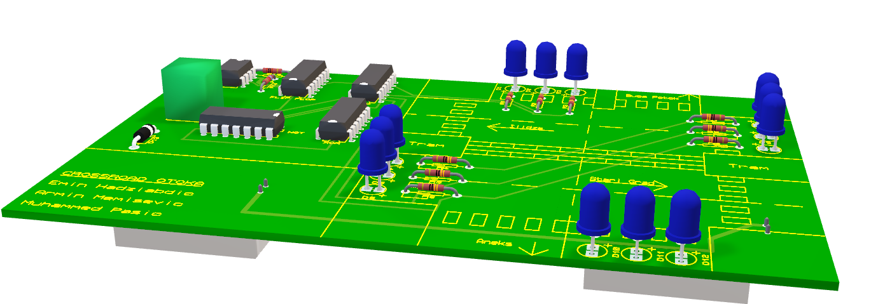
DIGITAL IMPLEMENTATION & SIMULATION – Simulation
Title / Main claim
text
Title / Main claim
text
Title / Main claim
text

Slide 9
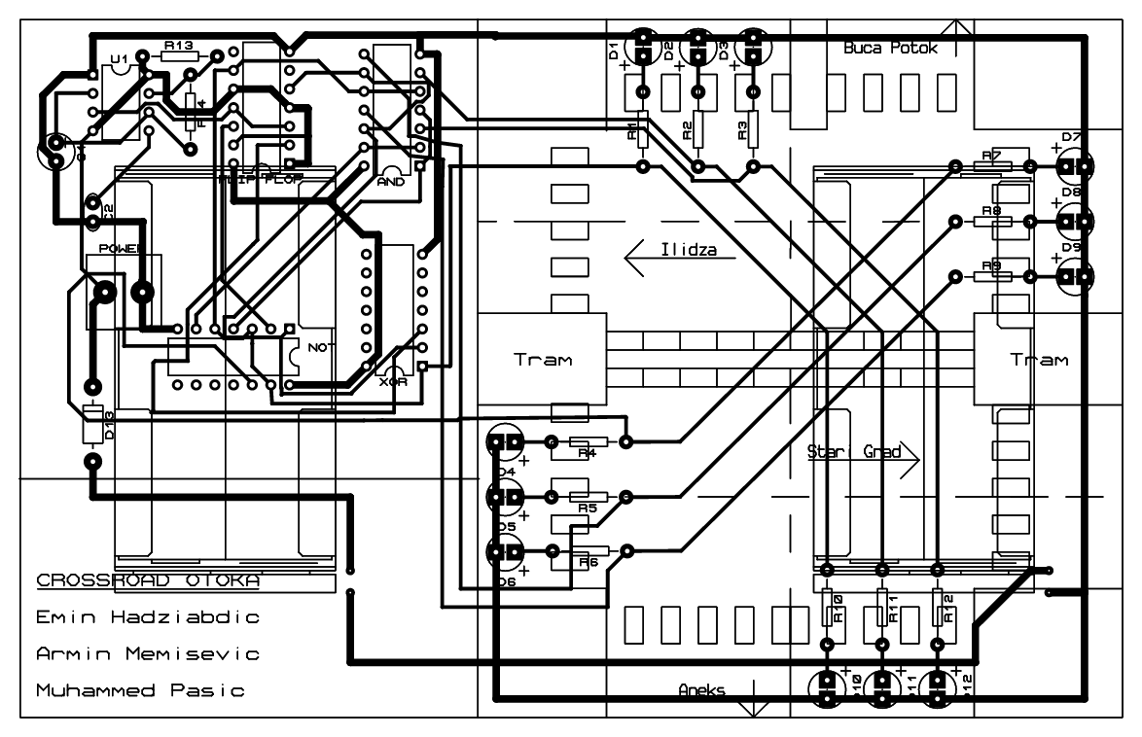
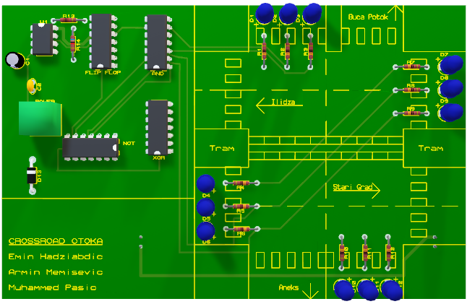
DIGITAL IMPLEMENTATION & SIMULATION – PCB Design
Title / Main claim
text
Title / Main claim
text
Title / Main claim
text

Slide 10
OTOKA CROSSROAD · FORMAL MODELS · ETF SARAJEVO
PRACTICAL IMPLEMENTATION

Slide 11
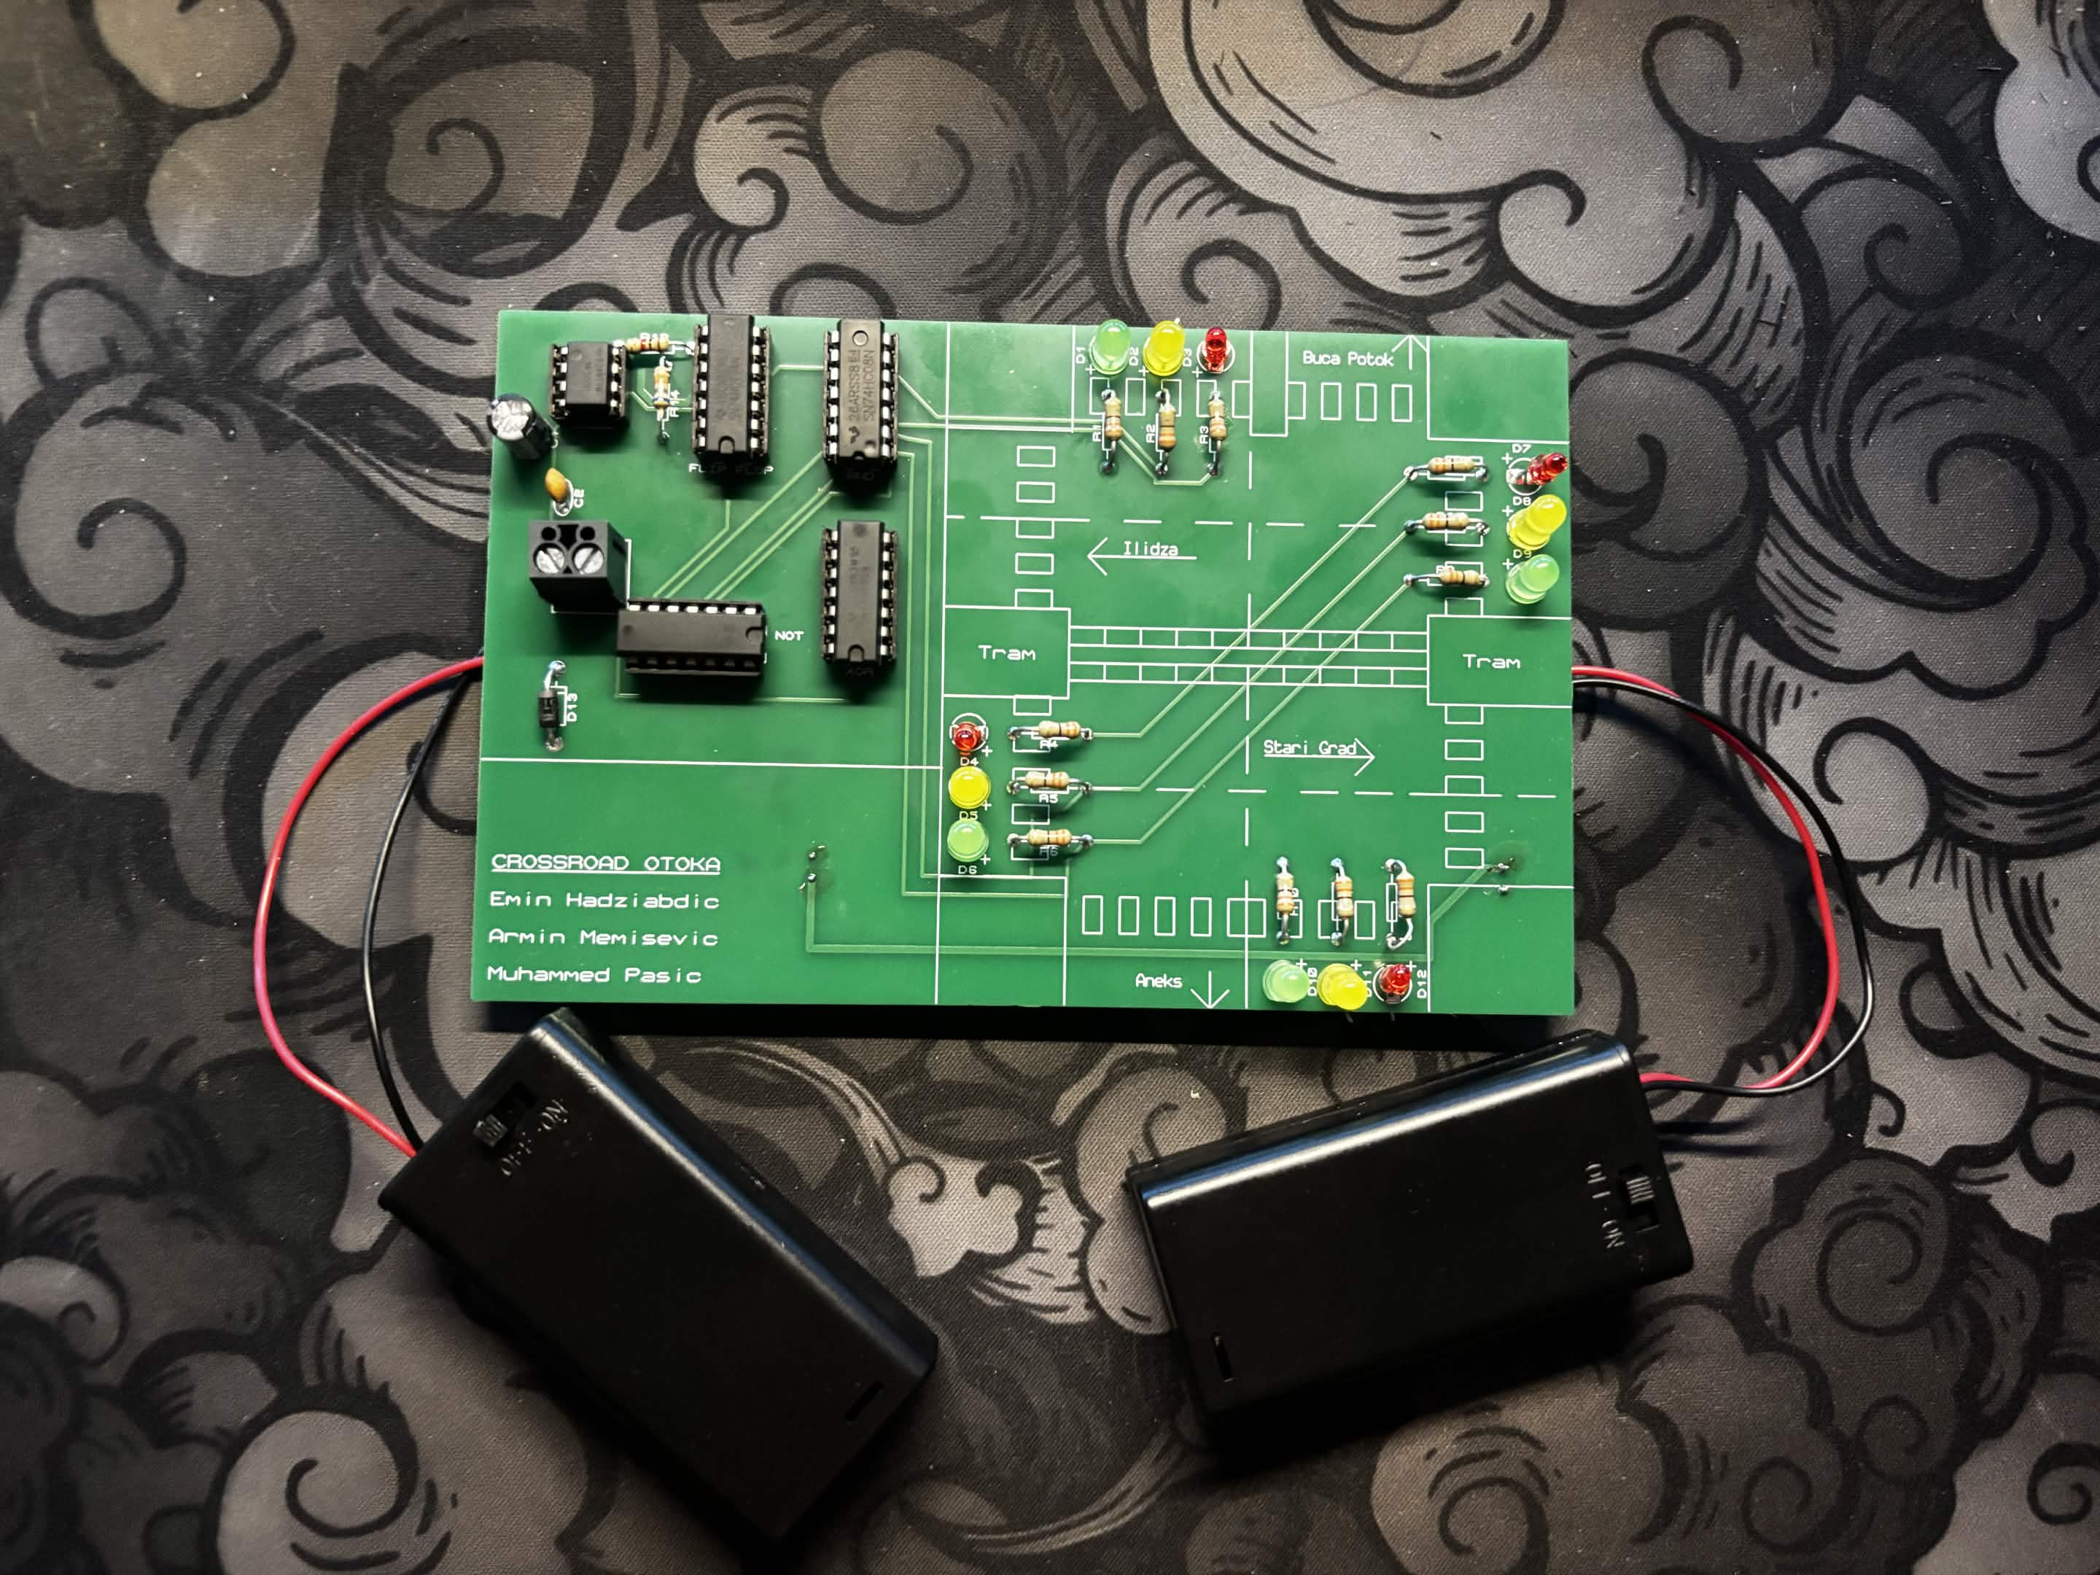
OTOKA CROSSROAD · FORMAL MODELS · ETF SARAJEVO
5 · Practical implementation — layout to solder
T40/T20 routing · Gerber X2 · assembled & powered.
POWER terminal — use this
Straight to the 5 V rail, no diode. Feed regulated 5 V only (USB bank via cut lead). Reversing it is unprotected.
B1 pads — battery input
Unfitted through-holes via D13 (1N4007). 4×AA ≈6 V dropped toward 5 V + reverse blocking. Not the terminal path.
TEMPLATE
BUILT · SOLDERED · POWERED
Five DIPs · twelve LEDs as four heads · resistor banks · single POWER terminal · B1 left unfitted. The soldered board is the physical realisation of the proven controller.

Slide 12
OTOKA CROSSROAD · FORMAL MODELS · ETF SARAJEVO
Conclusion — proven, then built
Six properties · four models · one board.
Reachability
exactly 4 phases
Deadlock-free
out-degree 1
Liveness
green ≤2 ticks
TEMPLATE
Safety ×2
tautology + invariants
Sequencing
yellow unskippable
Robustness
U≈47.95 / 42.05

